Slide 1
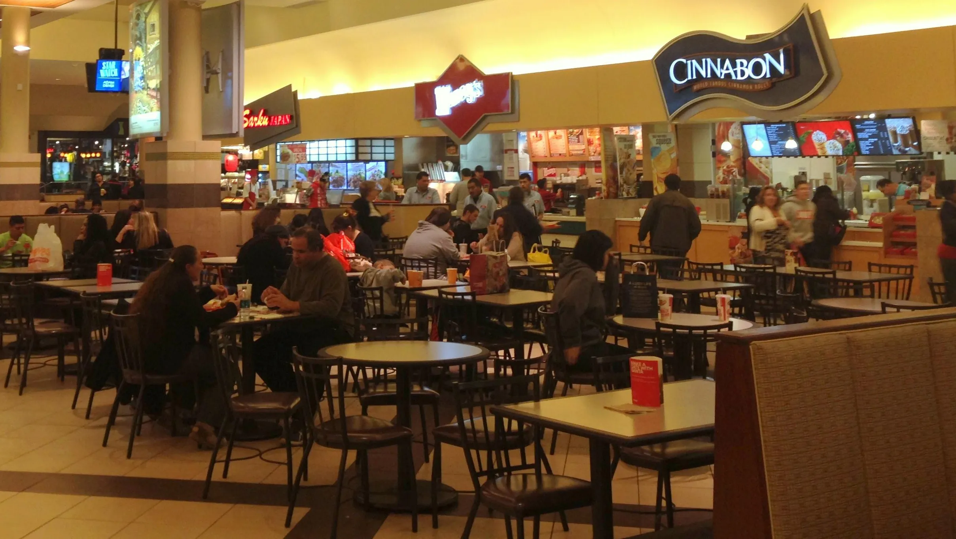
Mall food.

Slide 2
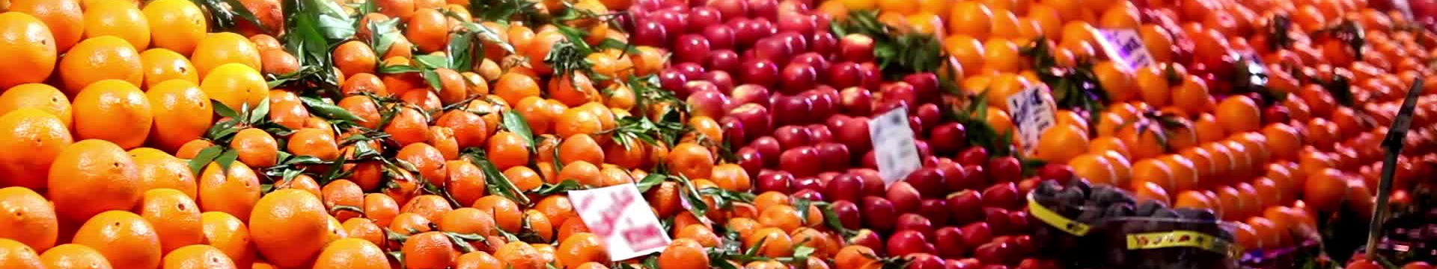
In the malls there are many varieties of food where we can find what we want:
Fast food:
healthy food:
drinks:
Hotdog
pizza
hamburgers
etc
Fruits
salads
Vegetables
etc.
coffee
juices
energy drinks
etc.

Slide 3
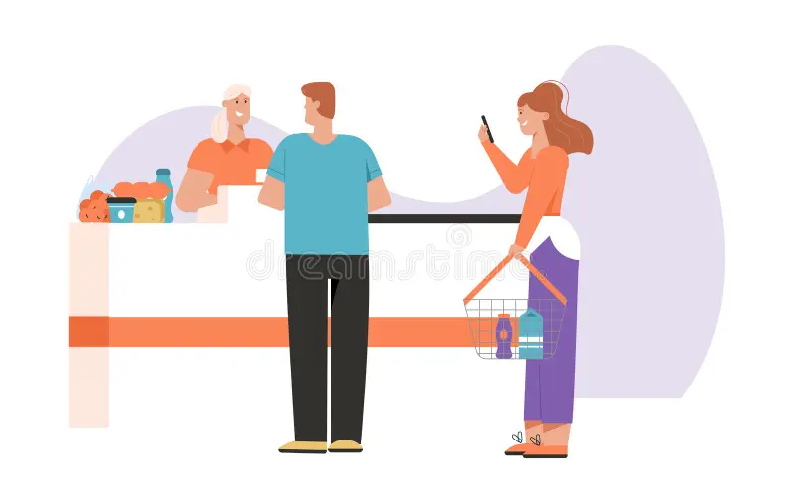

Are these common questions that are asked when we want to buy food?
What kind of food do I want?
How much money do I have to spend?
What options are available?
How healthy is the food?
How fast can I get my food?

Slide 4
Conversation.
A: Hello, how are you?
B: Hello, I'm fine. And you?
A: I'm fine too. What have you been doing?
B: I just bought some stuff, and I was thinking about getting some food. Would you like to eat something?
A: Sure, I'd love to. What options are there here?
B: There are many options, but I really like Italian food. Do you like pizza?
A: Yes, I love pizza. What place do you recommend?
B: There's a pizza place around here that's really good. It's called Pizza Express. They have a wide variety of options and it is very tasty.
A: That sounds good. It is expensive?
B: It's not very expensive. You can get a personal pizza for about $5 bucks.
A: That sounds reasonable. How is the service?
B: The service is very good. The employees are very friendly and do a great job.
A: Great, sounds like a good option. Where are you?
B: It's right next to the electronics store. Come on, I'll take you there.
A: Great! I'm starving.
B: Perfect! Let's go to Pizza Express.

